Slide 1
Take Home Presentation
Henry Izere

Slide 2

About me
Name: Henry Christian Izere
Origin: Kigali, Rwanda
School: University of Maine, Orono
Major: Computer Engineering, 2024
Hobbies: Basketball, Guitar, and Swimming
Languages: English, French, Kinyarwanda

Slide 3
Overview
Grid Seat Occupancy
ATM System Design
Shortest Distance Between Words

Slide 4
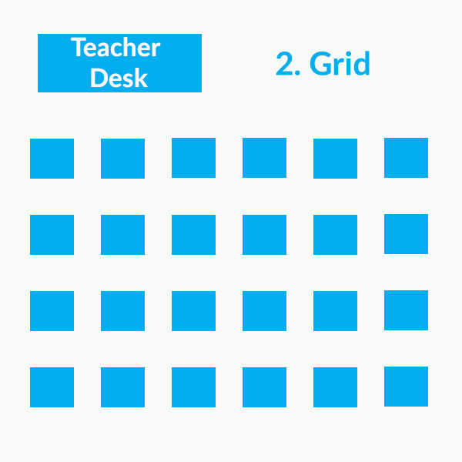
Grid seat Occupancy
.

Slide 5
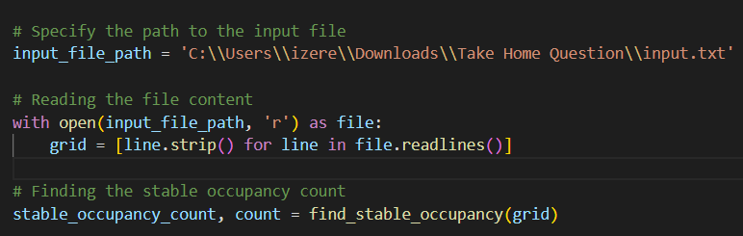
1.1 Read input.txt
.

Slide 6
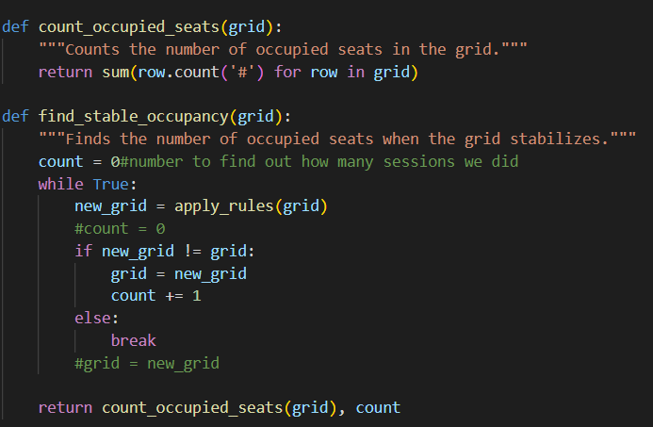
1.2 Find Stable Occupancy
.

Slide 7
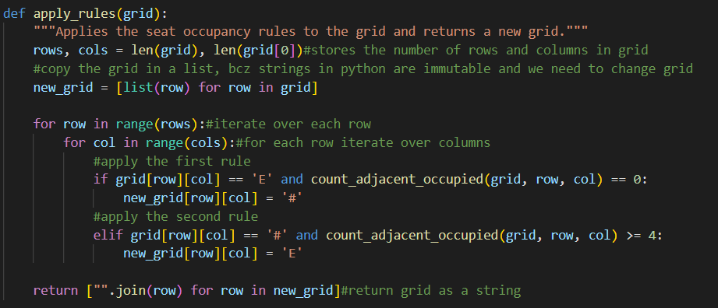
1.3 Apply Rules to Current grid
.

Slide 8
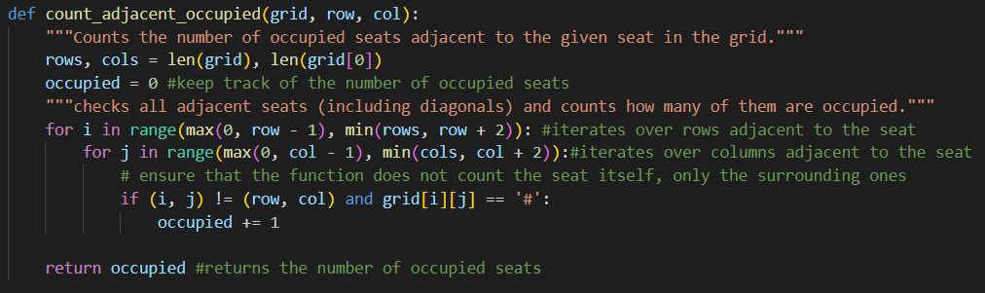
1.4 Count Adjacent Occupied Seats
.

Slide 9
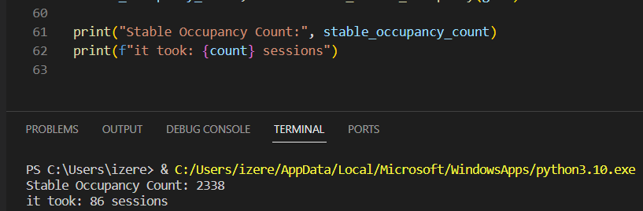
1.5 Print Results
.

Slide 10
1.6 Time and Space Complexities
def count_adjacent_occupied(grid, row, col):
Time: O(1) because it iterates over at most 8 adjacent cells.
Space: O(1) as it uses a fixed amount of extra space.
def apply_rules(grid):
Time: O(rows * cols) for iterating over each cell in the grid
Space: O(rows * cols) for creating a new grid of the same size.
def count_occupied_seats(grid):
Time: O(rows * cols) as it iterates over each cell in the grid.
Space: O(1) since it only uses extra space for the counter.
def find_stable_occupancy(grid):
Time: O(k * rows * cols), where k is the number of iterations required to reach stability.
Space: O(rows * cols) for storing the new grid state in each iteration.

Slide 11
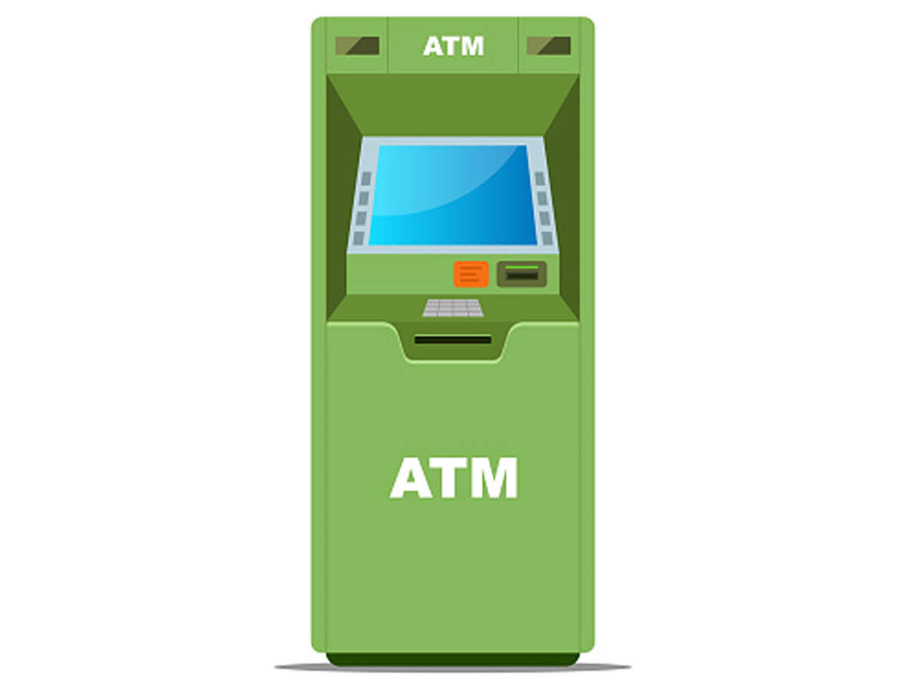
2. ATM
An Automated Teller Machine (ATM) is an electronic telecommunications instrument that provides the clients of a financial institution with access to financial transactions in a public space without the need for a cashier or bank teller.

Slide 12
2.1 System Requirements
Card reader: to read the users’ ATM cards.
Keypad: to enter information into the ATM e.g. PIN. cards.
Screen: to display messages to the users.
Cash dispenser: for dispensing cash.
Deposit slot: For users to deposit cash or checks.
Printer: for printing receipts.
Communication/Network Infrastructure: it is assumed that the ATM has a communication infrastructure to communicate with the bank upon any transaction or activity.

Slide 13
2.2 Users
The user can have two types of accounts: 1) Checking, and 2) Savings, and should be able to perform the following five transactions on the ATM:
Balance inquiry: To see the amount of funds in each account.
Deposit cash: To deposit cash.
Deposit check: To deposit checks.
Withdraw cash: To withdraw money from their checking account.
Transfer funds: To transfer funds to another account.

Slide 14
2.3 Use Cases
Operator:
Turning the ATM ON/OFF using the designated Key-Switch.
Refilling the ATM with cash.
Refilling the ATM’s printer with receipts.
Refilling the ATM’s printer with INK.
Take out deposited cash and checks.
Customer:
Balance inquiry
Cash withdrawal
Deposit funds
Transfer funds
Bank Manager:
Generate a report to check total deposits.
Generate a report to check total withdrawals.
Print total deposits/withdrawal reports.
Checks the remaining cash in the ATM.

Slide 15
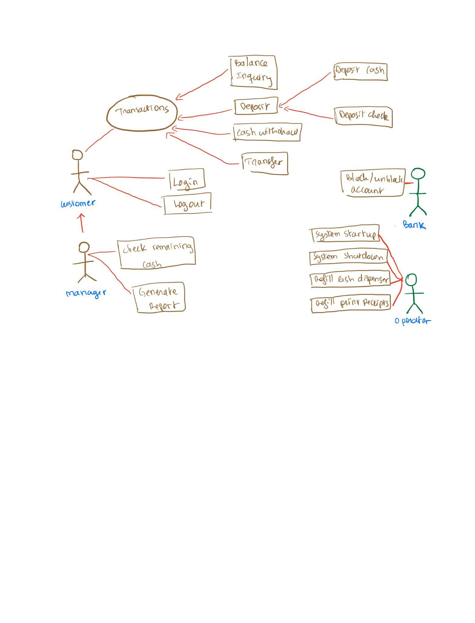
2.3.1 Use Case chart
.

Slide 16
2. 4.1 ATM Systems Main classes, Part1
ATM: The main part of the system for which this software has been designed. It has attributes like ‘atmID’ to distinguish it from other available ATMs, and ‘location’ which defines the physical address of the ATM.
CardReader: To encapsulate the ATM’s card reader used for user authentication.
CashDispenser: To encapsulate the ATM component which will dispense cash.
Keypad: The user will use the ATM’s keypad to enter their PIN or amounts.
Screen: Users will be shown all messages on the screen and they will select different transactions by touching the screen.
Printer: To print receipts.

Slide 17
2.4.2 ATM Systems Main classes, Part2
DepositSlot: User can deposit checks or cash through the deposit slot.
Bank: To encapsulate the bank which owns the ATM. The bank will hold all the account information and the ATM will communicate with the bank to perform customer transactions.
Account: We’ll have two types of accounts in the system: 1)Checking and 2)Saving.
Customer: This class will encapsulate the ATM’s customer. It will have the customer’s basic information like name, email, etc.
Card: Encapsulating the ATM card that the customer will use to authenticate themselves. Each customer can have one card.
Transaction: Encapsulating all transactions that the customer can perform on the ATM, like BalanceInquiry, Deposit, Withdraw, etc.

Slide 18
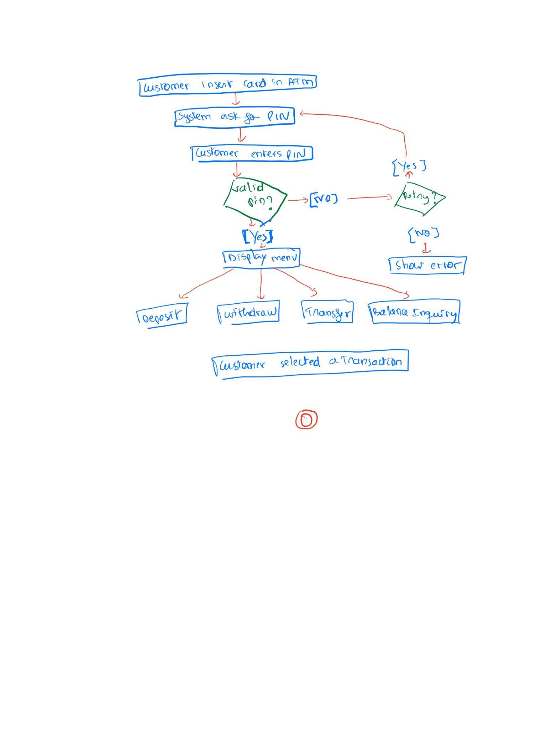
2. 5 Activity Diagrams
2.5.1 Customer Authentication
.

Slide 19
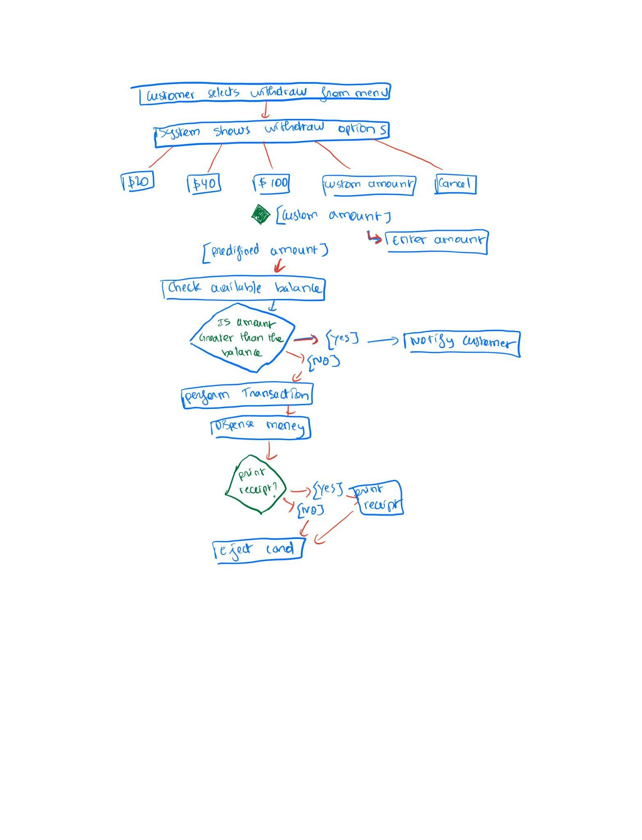
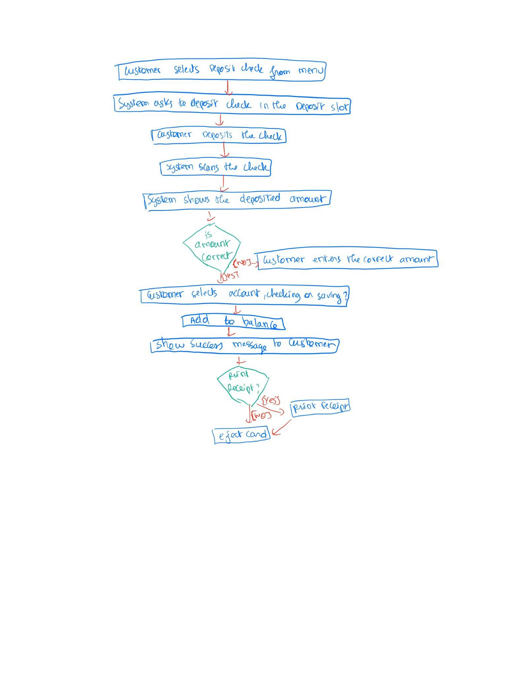
2.5.2. Cash Withdraw 2.5.3. Deposit Check
.
.

Slide 20
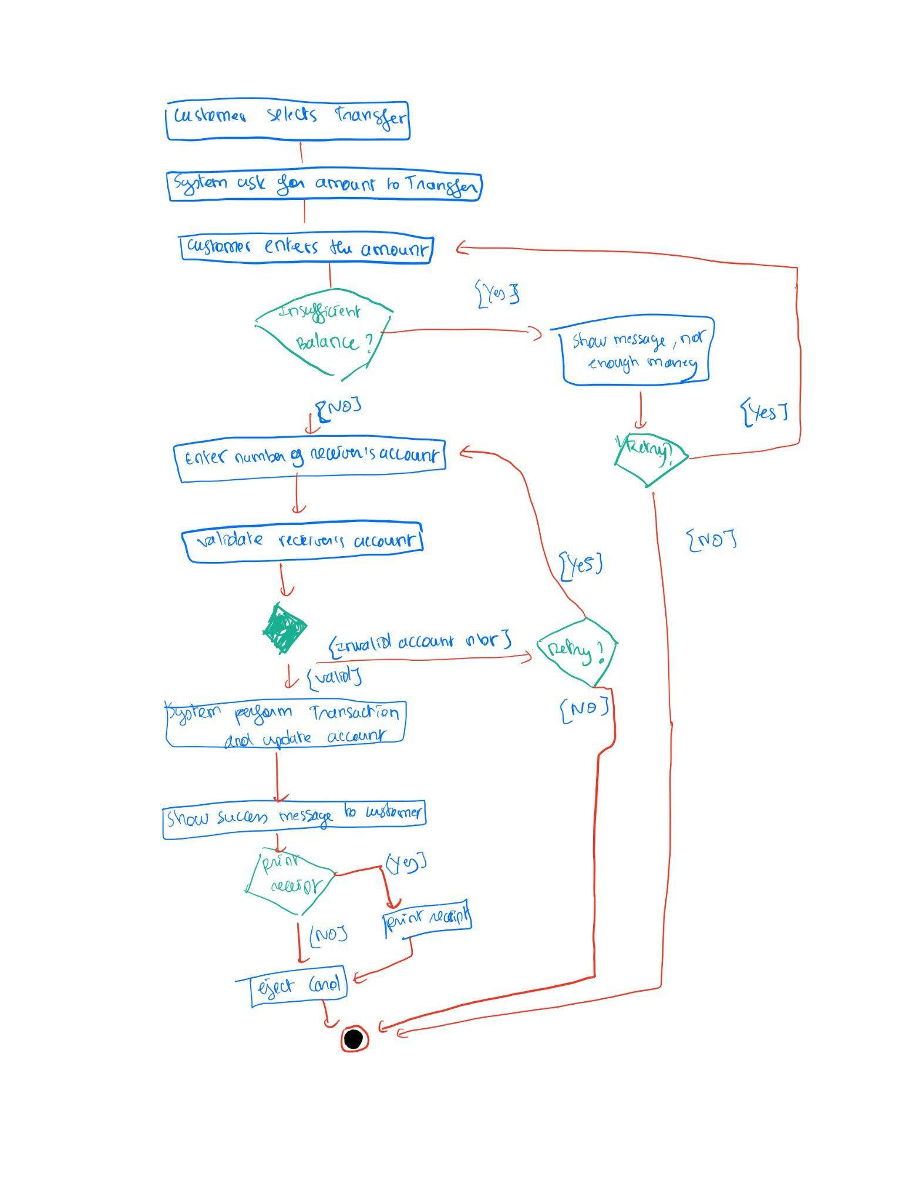
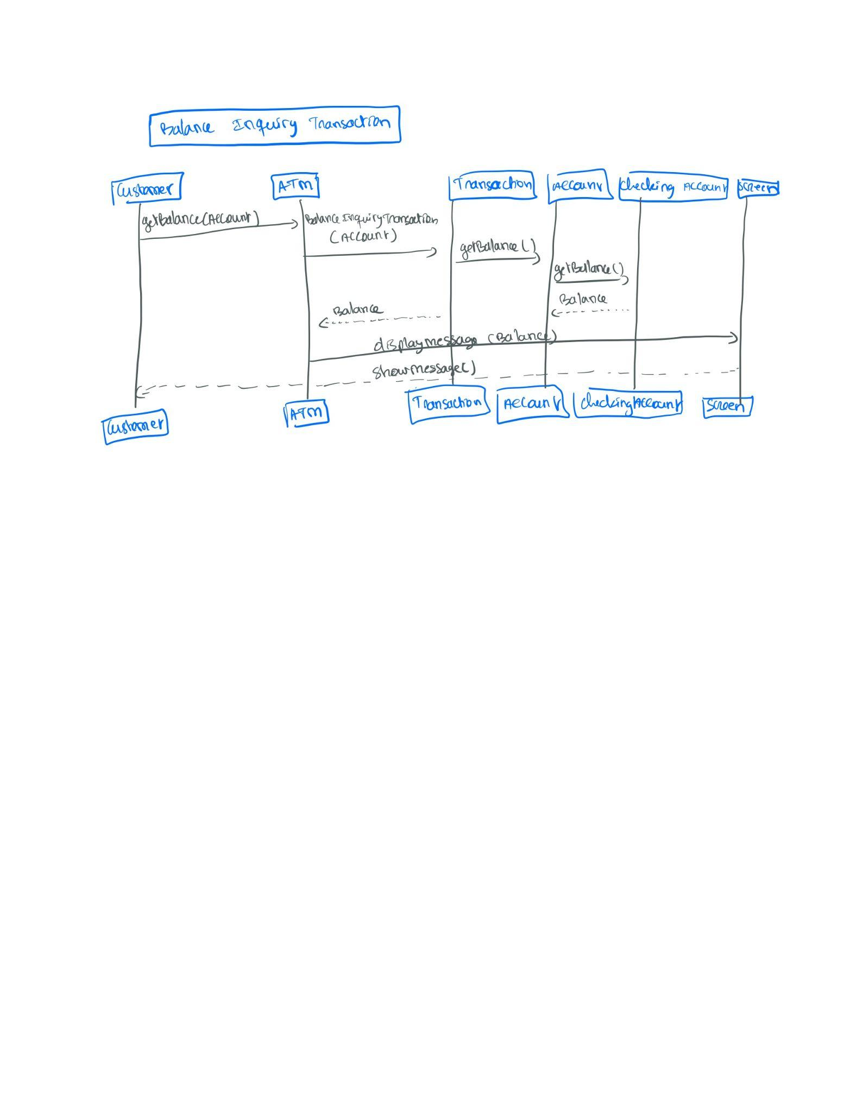
2.5.4. Fund Transfer 2.5.5. Balance Inquiry
.
.

Slide 21
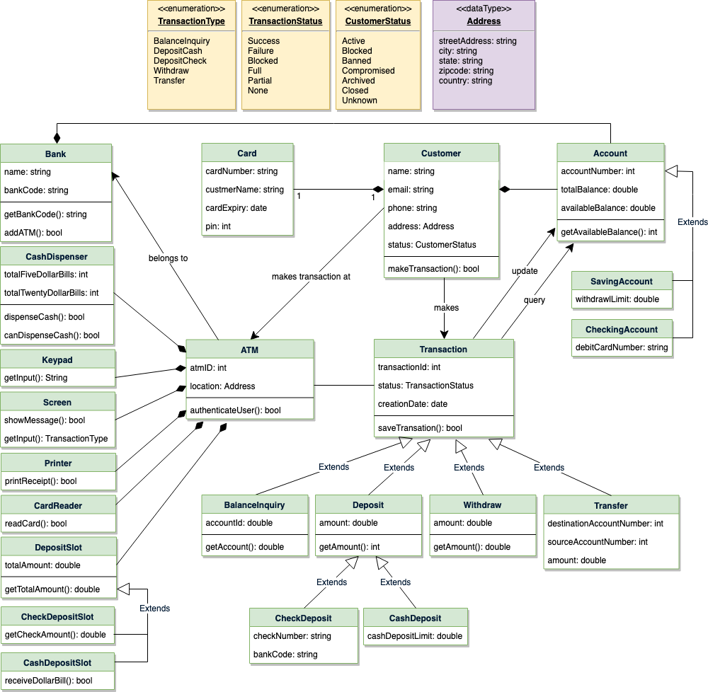
2.6 Class Diagram for ATM

Slide 22
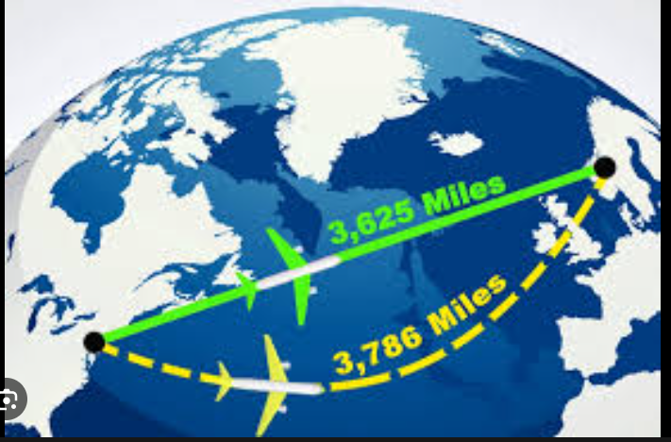
3. Shortest Distance
.

Slide 23
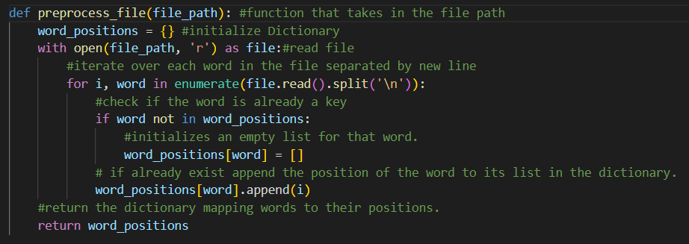
3.1 Preprocess File
.

Slide 24
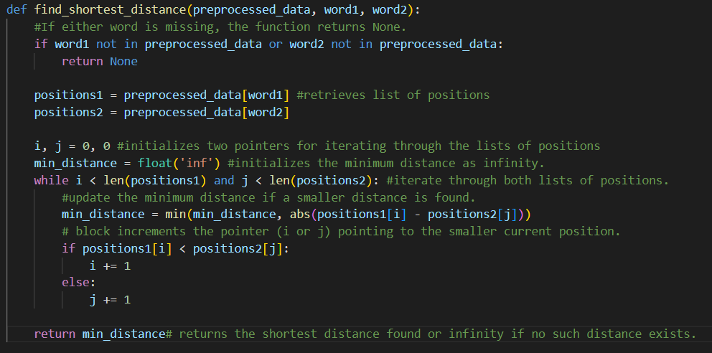
3.2 Find Shortest Distance Function
.

Slide 25
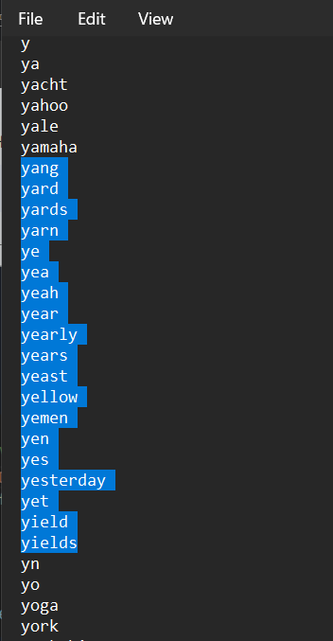
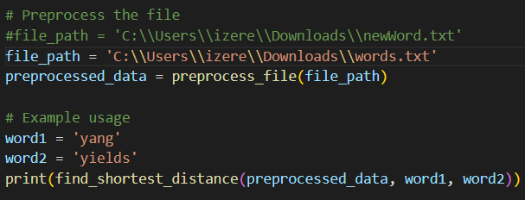
3.3.1 Test case 1
.

Slide 26
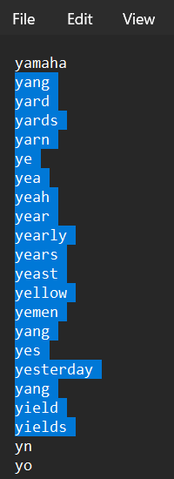
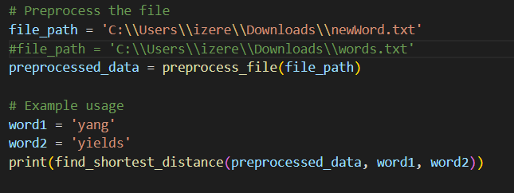
3.3.2 Test Case 2
.

Slide 27
3.4 Time and space complexities
def preprocess_file(file_path):
Time: O(N), where N is the number of words in the file. It iterates through each word once.
Space: O(N), as it stores each word and its positions in a dictionary.
def find_shortest_distance(preprocessed_data, word1, word2):
Time: O(M + K), where M and K are the number of occurrences of word1 and word2, respectively.
Space: O(1), as it only uses a constant amount of extra space for pointers and the minimum distance variable.

Slide 28
Acknowledgments
Joel Schwartz, Hiring Manager
Guy Fisher
Mark Streitfeld
Thank You Teradyne Team.
It will be an honor to join and innovate with the Team!

Slide 29

Questions
.

Slide 30
2.2 How does ATM work
It is managed by an operator responsible for refilling cash and receipts and ensuring smooth operations.
The ATM is designed to serve one customer at a time and remains operational throughout the service.
Transactions begin with the user inserting their ATM card containing account details, followed by entering their PIN for authentication.
The ATM communicates with the bank for user authentication, a necessary step for conducting any transactions.
The user's ATM card remains inside the machine until the session ends, which can be done anytime by pressing the cancel button, triggering the card's ejection.
An internal transaction log records details, including hardware failures, to aid the operator in resolving issues.

Slide 31
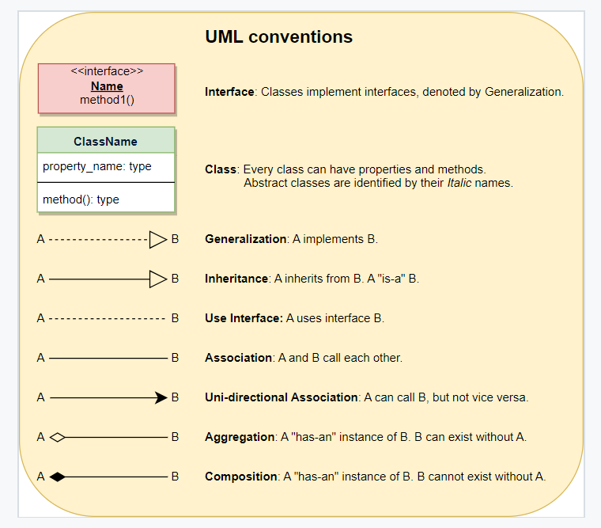
UML for ATM

